Slide 1
Matlab程式設計_3_30
助教:金郁善

Slide 2
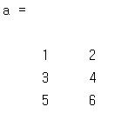
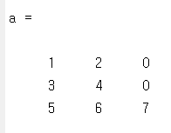
Creating matrices
a = [1 2; 3 4];
x = [5 6];
a = [a; x]
a(3,2)
a(5)
a(3,3) = 7

Slide 3
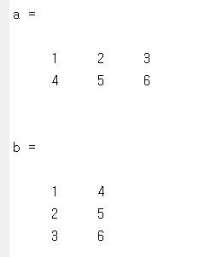
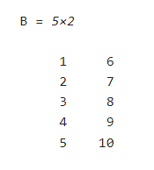
Transpose
a = [1:3; 4:6]
b = a'
reshape
A = 1:10;
B = reshape(A,[5,2])

Slide 4
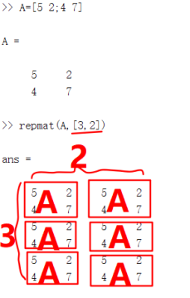
repmat

Slide 5
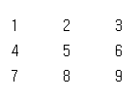
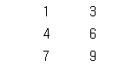
Deleting rows and columns
a = [1:3; 4:6; 7:9]
a(:,2) = [ ]
a = [1:3; 4:6; 7:9]
cc=logical([1 0 1])
b = a(:, logical([1 0 1]))
c = a(:, [1 3])

Slide 6



Interchanging rows and columns
A=[1 3 4; 2 4 5]
A([1 2],:)=A([2 1],:)
%rows
A(:,[2 3])=A(:,[3 2])
%columns

Slide 7
Linear equations
A = [3 2 -1; -1 3 2; 1 -1 -1]
b = [10 5 -1]'
x = A \ b
r = A*x – b %residual
det(A) %determinant
rcond(A) %condition estimator
3x+2y-z=10
-x+3y+2z=5
x-y-z=-1
If C is near 0, the matrix is nearly singular and badly conditioned.
If C is near 1.0, the matrix is well conditioned.

Slide 8
HOMEWORK

Slide 9
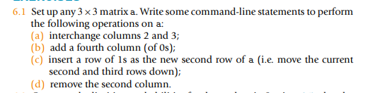

Slide 10


Slide 11
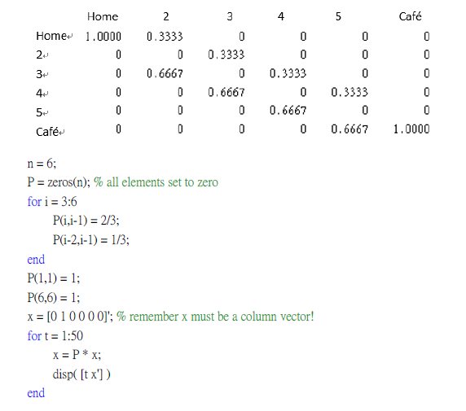

Slide 12
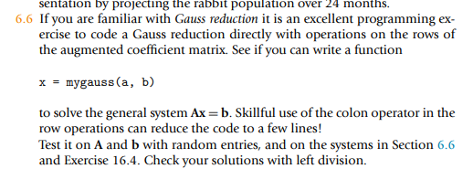

Slide 13
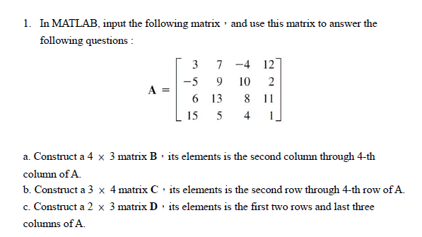

Slide 14
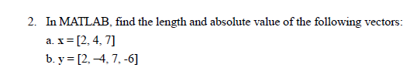

Slide 15
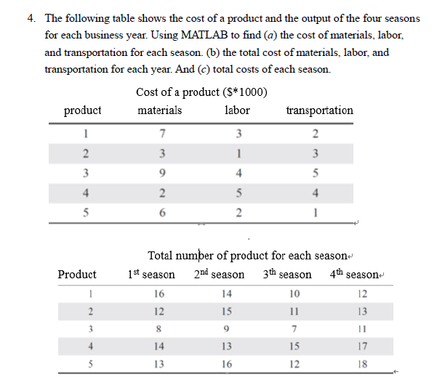

Slide 16
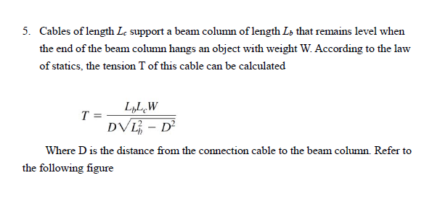

Slide 17
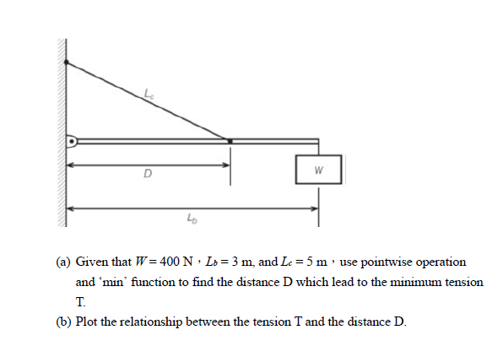

Slide 18
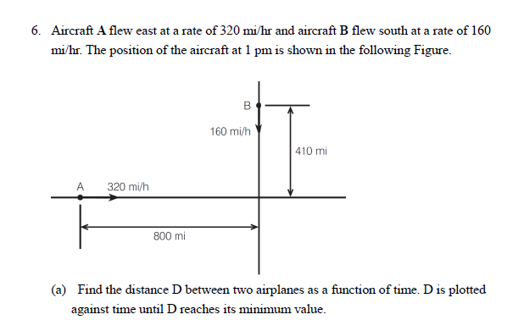

Slide 19
